Slide 1
Seoul, Home of Creative Culture
- Seoul’s Cultural Policy Roadmap -
Suh, Nowon, Director
Cultural Policy Division, Seoul Metropolitan Government

Slide 2
Table of Contents
1. Overview of Seoul
2. Importance of cultural policy in the global age
3. Outcome of cultural administration in the 4th
elected government
4. The 5th elected government’s Vision and Goals
for Cultural Policy
5. Projects: 3 directions with 11 projects
2

Slide 3
Seoul_creative city
Overview of Seoul
Overview of Seoul
서울시 개요
3

Slide 4
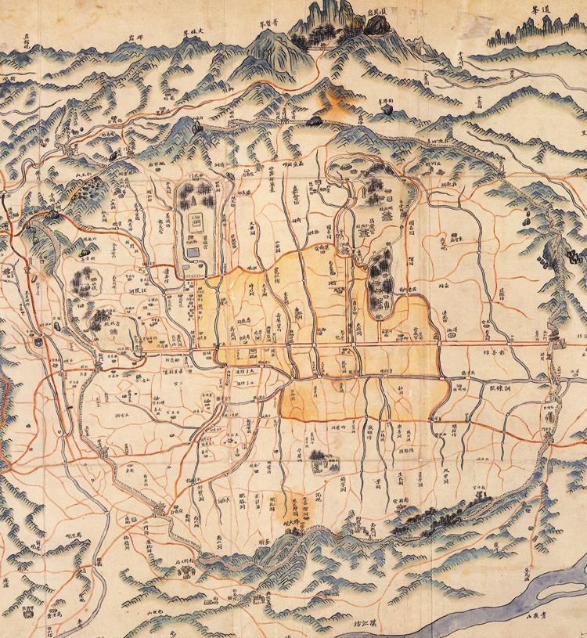
Seoul, the Capital City of the Republic of Korea
Seoul_creative city
Seoul has been the center of the country in its long history from the prehistoric era to the present day
Seoul’s emergence as the capital city occurred during the early days of Baekje (BC18-AD660). Baekje’s rich and brilliant culture became the basis for cultivating Korea’s cultural history.
Seoul again became the capital of the Joseon Dynasty with its foundation in 1394. Since then, the city has been maintained as the historical center of the country.
4

Slide 5
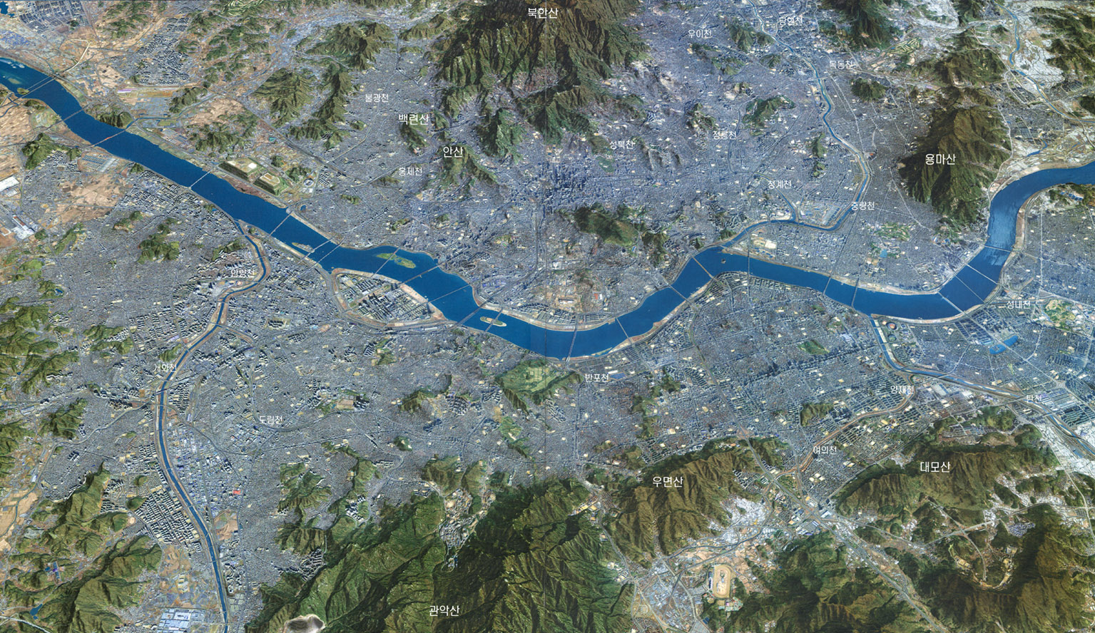
Coexistence of Traditional and Modern Culture
Seoul_creative city
Population: 10,464,000
Area: 605.25㎢
(0.6% of the Korean Peninsula)
- by 12.31 2009.
Now in its 600th year of official history, Seoul is a city where Korea’s traditional and modern cultures coexist. Geographically, it is an extraordinary example of good location, as mountains, rivers and urban spaces all combine to produce a picture-perfect city.
5

Slide 6
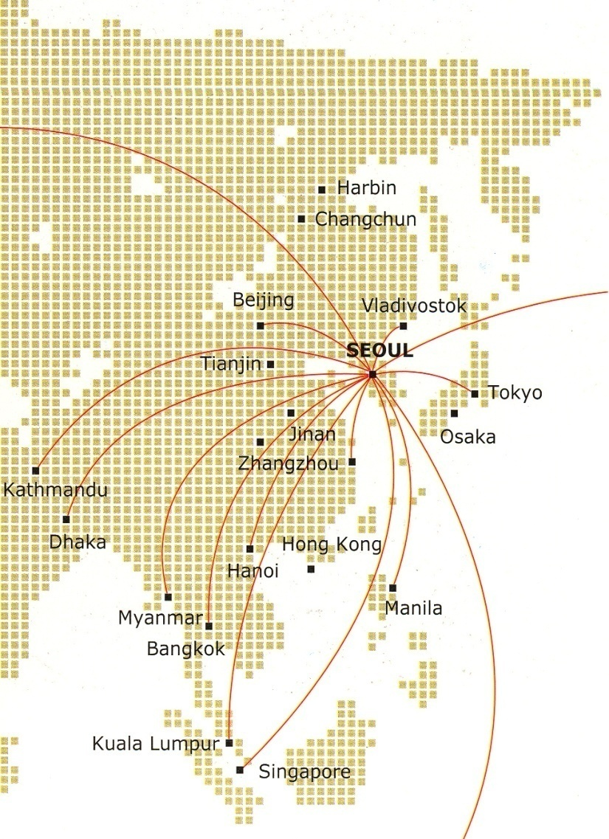
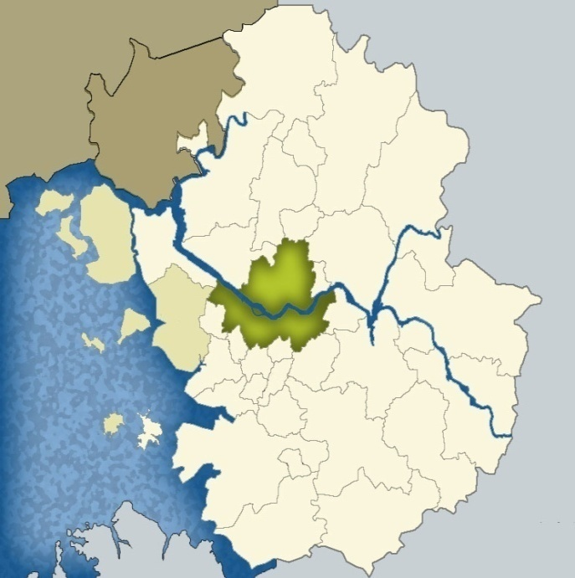
Center of Ease Asia 동북아의 중심
Seoul_creative city
Seoul in Asia
Seoul in Korea
Seoul in Capital Region
North Korea
SEOUL
SEOUL
Seoul is a hub of 43 cities in East Asia with more than 1.8 billion citizens within 3 and a half hour flight.
Also has excellent transportation system including international airport, KTX(Korea Train Express), expressways and near harbors
6

Slide 7
Parks and woods in Seoul 서울의 공원
Seoul_creative city
total area of parks 181.04㎢
(per capita park area 16.19㎡)
7

Slide 8
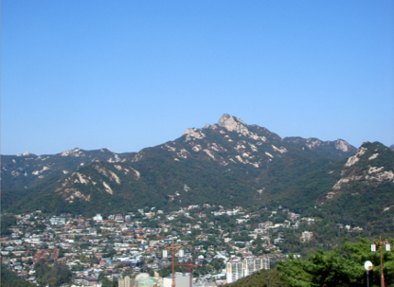
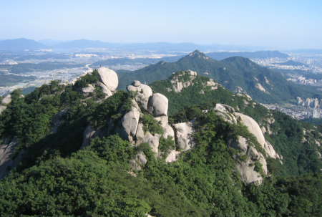
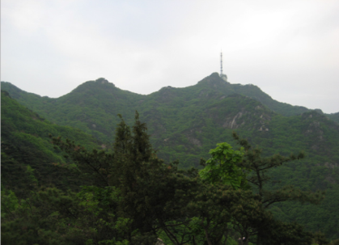
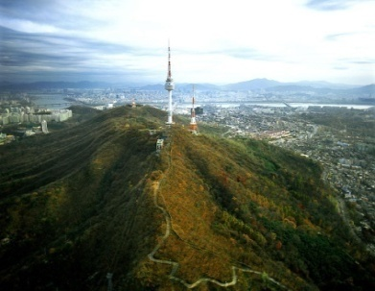
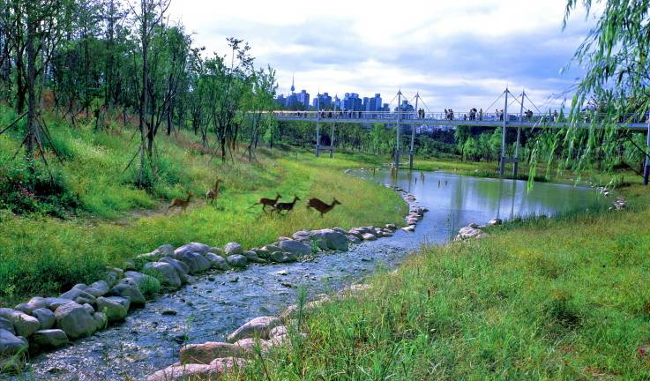
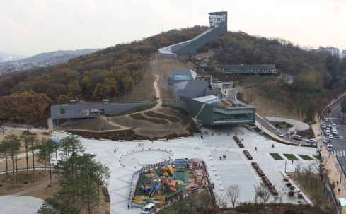
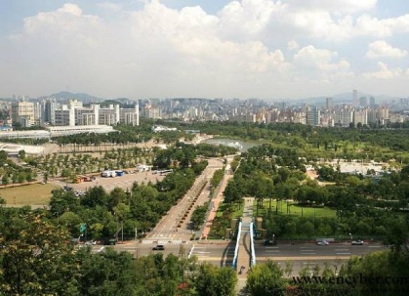
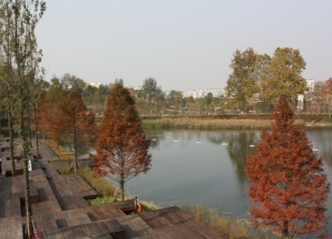
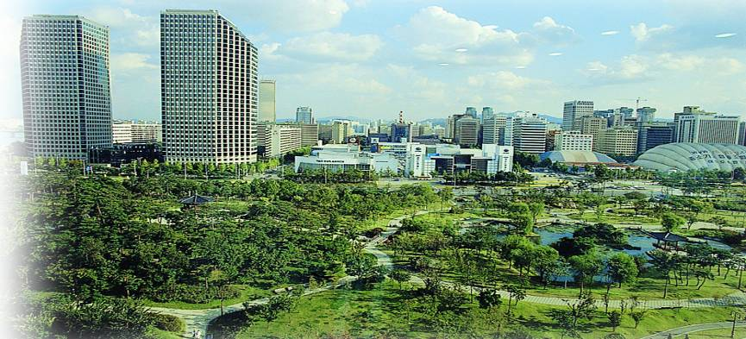
Parks and woods in Seoul 서울의 공원
Seoul_creative city
Mountains of Seoul
Woods
Parks
8

Slide 9
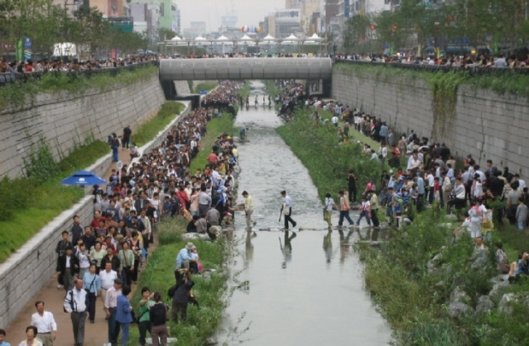
Water Fronts 서울의 수변공간
Seoul_creative city
Streams-Cheongye, Tancheon,, Hongje, Joonglang, Anyang, Nanji
9

Slide 10
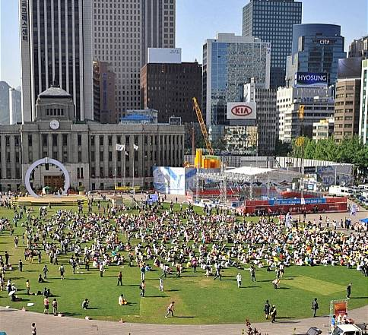
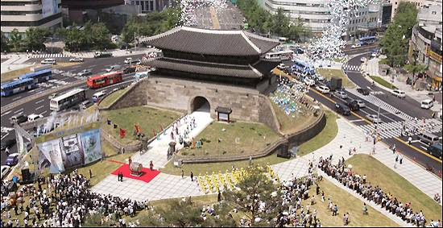
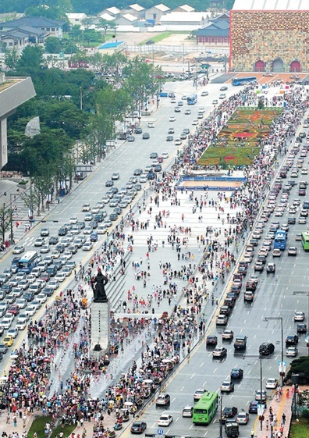
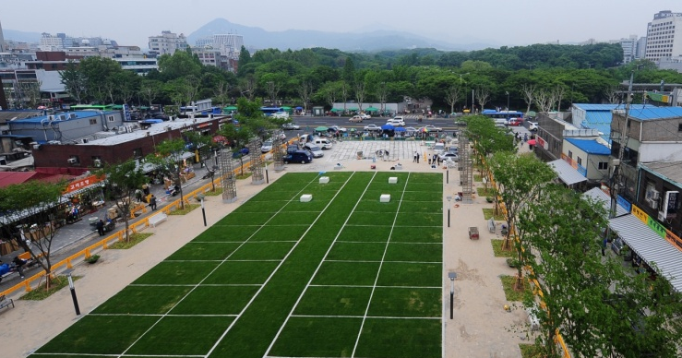
Plaza and Green Area 광장
Seoul_creative city
Green areas in city centre – Square(plaza)
Seoul plaza, Sewoon Green Plaza and Gwanghwamun Square
10

Slide 11
11

Slide 12
Importance of Cultural Policy
in the Global Age

Slide 13
Trends in global city competition
Accelerated globalization, the era of city
The world is being rearranged into a city-centered global market.
Megacity’s competitiveness = National competitiveness
Stronger competition with global cities in comparative advantage
The city is a brand, selected like goods by comparison.
High life quality / global standard of City management
13

Slide 14
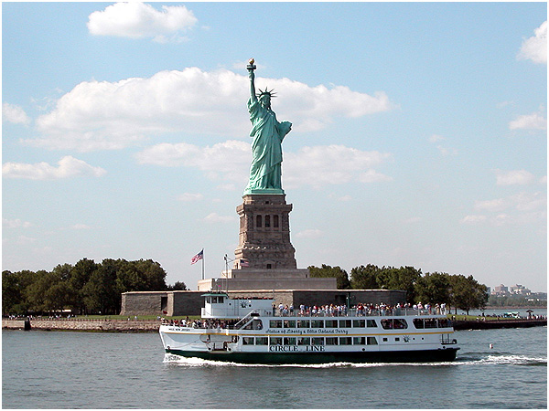
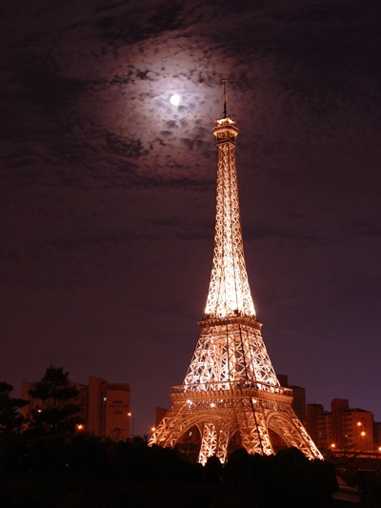
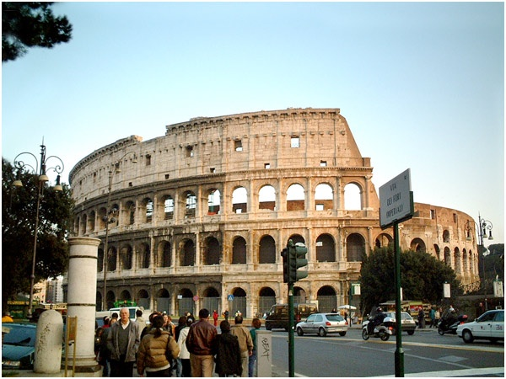
Competitiveness trend of global cities
Accelerated competition in city brands
Global cities have pushed ahead with the cultural city movement
for the last 20 years.
Required to create the unique brand of Seoul
14

Slide 15
Competitiveness trend of global cities
20th
7th
10th
9th
Competitive
edge
120
cities
35
cities
65
cities
75
cities
Global City
Competitive-ness Index
(GCCI)
Global Power City Index
(GPCI)
Global
City
Index
(GCI)
Worldwide Centers of Commerce Index
(WCCI)
Life quality
81st
13th
58th
215
cities
40
cities
140
cities
Mercer’s
Life Quality Index
Wealth Report
Global City Index
(GCI)
Seoul takes 10th place or higher in the world’s city competitiveness and is on the upturn.
But, it’s required to enhance life quality suitable for city competitiveness.
15

Slide 16
Importance of city cultural policy
Culture
Healthier life with human dignity
Providing good leisure and regeneration
Mentally healthy life
A life co-existing with people,
history, and the environment
Leading a deep-rooted life
16

Slide 17
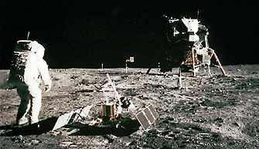
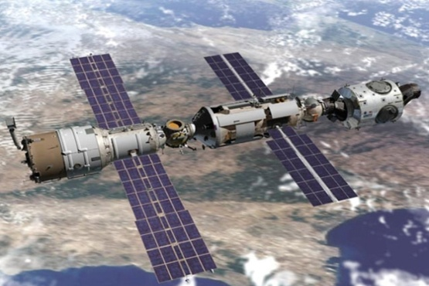
Importance of city cultural policy
Culture
The sources for creativity
that hold the 21st century’s growth power
Before the 19th century
Industrialization
in the 20th century
Cultural age
in the 21st century
A gap between reality and ideals
A dream is a dream due to technical restriction.
Technology is still the limitation to realize a dream.
The lack of creativity hinders the full use of technology even in the era when a dream can come true.
17

Slide 18
Importance of city cultural policy
Culture
City’s EQ
City’s EQ in the 21st century of sensitivity
Warm, personable city
Physique
(Global size)
+
Well-balanced
full growth
Culture = EQ
IQ
(Intelligent city)
Culture
City’s unseen infrastructure
For example, the same effect as the physical facilities like roads, etc.
18

Slide 19
Importance of city cultural policy
not a simple art city.
Culture city
City
management
Life style Full of global citizens/daily life of cultural arts
City management Focused on life with human dignity
Culture
Citizen’s
life
Activities
Urban economy Based on creativity, and other capabilities
Shared with nature, history, preservation,
Urban space
and future generations.
Long-term vision plan to fulfill, supplement, and develop together with citizens
19

Slide 20
Goal and philosophy of the cultural city of Seoul
Goals
Seoul,「Cultural city being created together with citizens」
World’s First Class City
Competitiveness
Cultural city
Attraction
20th century
21st century
Keeping up with advanced foreign models
Global model, creating the cultural city together
20

Slide 21
Goal and philosophy of cultural city, Seoul
People
Philosophy
Communica-
tion
Globally
Unique
People-
oriented
Participa-
tion
Happy life
People-oriented
Put people before other values
Humanism
■ People, the highest standard for urban management
- People nurture a city.
City’s contribution to people’s growth/development
- Natural, traditional recovery
To live like a human being
Communication-
oriented
From a closed “block” to a communicating “net”
■ The role of the social practice of art in recovering a cultural community.
Communication
A community gets restored by the citizen’s initiative based on the culture.
21

Slide 22
The Outcome of Cultural Adminstration of the 4th Elected Government

Slide 23
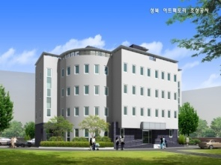
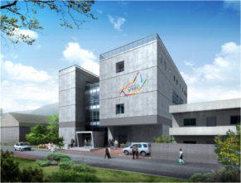
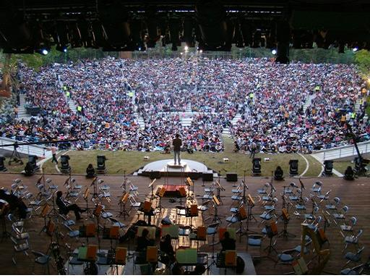
The 4th elected government’s culturenomics
Declared the city of creativity & culture
Preparing/
executing strategy of culturenomics
Creating a higher value based on culture
Enhancing city competitiveness
_ Building up the basis of artistic creativity
_ Setting up a cultural urban environment
_ Raising Seoul’s city value and competitiveness
Using unused facilities to develop creative cultural foundation
_ Developed a variety of creative art spaces in 9 areas,
including Seogyo, Geumcheon, Mullae, Sindang, Yeonhui , etc.
_ Total 3 places additionally completed (Seongbuk, Gwanak, Hongeun)
Cultural oases at every corner of city
_ To be opened : Dream Forest, Neung-dong Forest Open-air Stage,
The Story of King Sejong, The Story of Admiral Yisunshin, and others
_ Developed landmark library, Seoul Baekje Museum,
Gocheok-dong Culture & Sports Complex, Hannam·Chang-dong
Special Theater, Northern City Art Museum

Slide 24
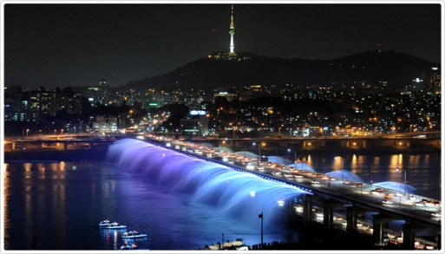
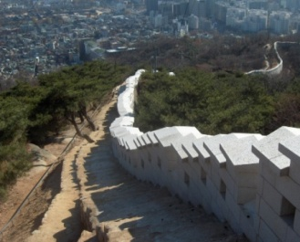
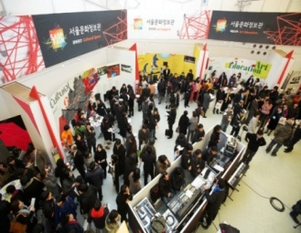
Extending an opportunity to enjoy culture and arts in daily life
_ 16 projects such as 1,000 won’s happiness, poet-flowing Seoul, visiting cultural performances, love tickets, and others
Constructing Seoul’s landmark cultural spaces like the Han River, etc.
_ Han River : 4 specialized districts, including a Floating Island, J-bug, etc.
_ Namsan (Mt.) : restoration of history, landscape, ecology-like fortress wall, waterway, etc.
Historic cultural urbanization by restoring and preserving cultural assets
_ Restored Seoul Fortress Wall(12.5km in total 18km) and Bukhansanseong Fortress
_ Restored and opened government cabinet’s remains n 6 places.
Creating jobs on the basis of cultural creativity
_ Incubated the Seoul-type of preliminary social businesses and held the first domestic culture and art support expo (2009)

Slide 25
The foundation of creative culture is accumulated
And the surroundings with citizens enjoying culture and arts
are largely improved.
Spaces
Creation
1 site (2006) ⇒ 9 sites (2009)
Performance · Exhibit
20 sites (2006) ⇒ 31 sites (2009)
Support for art promotion
5.8 billion won (2006) ⇒ 271 billion won (2009)
Cultural sharing
21 projects, such as 1,000 won’s happiness, visiting concerts,
Seoul Plaza with flowing culture and arts, and others
Size of audience
Satisfaction
in cultural environment
248,000 ⇒ 781,000
51% ⇒ 56%
(‘06)
(‘09)
(‘06)
(‘09)

Slide 26
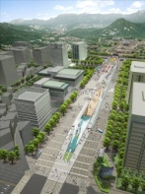
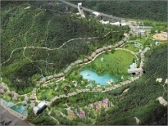
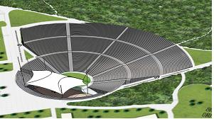
However, many things remain to be supplemented and developed
Gwanghwamun Square
Dream Forest
Needs exist for 4 large plazas, 4 large specialized districts in the Han River area, downtown parks, and various cultural contents
Cheonggye Plaza
Seoul Plaza
Neung-dong Forest Open-air Stage
Nanji District
Sungnyemun Plaza
Seoul Forest
Yeoido District
Banpo District
Ttukseom District
Visualization of citizen’s satisfaction & the outcome of the「Welfare Net」are needed.
Performance contribution – Visiting
Sharing seats – fee support/invitation
Free performance in open spaces for all
Culture arts education program
Cultural community activation
Cultural sharing with love, sharing with arts, Seoul Symphony Orchestra, visiting concerts, galleries and museums
Sejong, 1,000 won’s happiness in a city or town, invitation of the disadvantaged to the performance, culture vouchers, love tickets
Culture- and art-flowing Seoul Plaza, Seoul culture night, open space free performances
Child’s creative art tree, our town orchestra, and other programs
Cultural community in living spaces, creative space art, specialized local projects

Slide 27
Poor value-sharing and few available programs.
Restored Seoul Fortress Wall and Bukhansanseong Fortress
Excavated government cabinets and modern cultural assets
Traditional program of Namsan Hanok Village and Unhyeongung (Palace)
Changing of the Royal Guard, and Daily Ringing of the Bosingak Bell
New programs for The Story of King Sejong and The Story of Admiral Yisunshin
Citizen’s low awareness and historic
and cultural recognition
Lack of efforts to develop tourism
resources by establishing the cluster
of historic and cultural assets, etc.
Few permanent programs and low
attendance rates
Low attendance rates of cultural performances _ Around 10%, excluding movies
50%
100%
New
York
Source: Alliance for the Arts, 2002
Museum
12.7%
_New Yorker’s attendance rates
Music (49%), exhibitions (43%), movies (36%)
Art Museum
10.2%
Theater
12.2%
Concert hall
9.1%
Tokyo
Traditional space/
performance
16.8%
_ Tokyo citizen’s attendance rates
Movies (48.4%), fine arts (32.4%), music (30.3%), plays (17.1%)
Cinema
16.8%
58.2%
Sports events
9.9%
Seoul: Tokyo City, 2004
Source: Seoul Survey, 2009

Slide 28
To need fundamental efforts to upgrade the ‘Creative Cultural City, Seoul’
Han River
Renaissance
Establishing the Han River cultural axis to make the
world’s best waterside art spaces
Downtown/
Namsan Renaissance
Establishing a regional cultural belt to create a tourist
attraction
Creation space
Outposts for nurturing the cultural industry of pure arts
Restoration of historic and cultural assets
Developed for the discovery and use of culture assets’ values
Constructing landmark libraries
Providing citizens with the space for reading books at their leisure
Cultural welfare net
Realizing everyday and universal welfare by matching a
living space with a program

Slide 29
Vision and Goals of Cultural Policy
in the 5th elected Government

Slide 30
5th Government’s visions and goals for cultural administration
Visions
To transform Seoul into a “Cultural City Created Together”
Goals
Community culture supporting a happy and abundant life
Providing the citizens in the community with the opportunities for cultural creative activity
Expansion of the library and museum for more local users
Expanding the cultural art programs that citizens can participate in together
Promoting the creative industry,
an ocean of opportunity for creating jobs
Establishing the foundation of creative industry by supporting various creators and works
Operating DDP, which is an advance base for the creativity the industry of future food
Nurturing fashion, sewing, visual industry, and animation as the core industries of the future of Seoul
Using the historic and cultural resources in Seoul to establish smart tourism.
Key words
Communication
Human
Trust

Slide 31
Major Indices of Cultural Administration
Items | Index | Unit | 2011 | 2012 | 2013 | 2014 | Long-term (2020)
Culture | Village’s cultural space (town art house, book café, etc.) | (Places) | 11 | 79 | 139 | 200 | 375
 | Experience rate of art creation and presentation | (%) | 2.8('10) | 4 | 5 | 6 | 20
 | Cultural environment satisfaction | (Criteria: 10 points) | 5.9('10) | 6 | 6.2 | 6.4 | 7
Cultural Assets | Restored Hanyang Castle (Fortress Wall) | (m) | 213 | 86 | 252 | 1,731 | 4,001
 | Restored government cabinet’s remains | (Places) | 1 | 3 | - | 2 | -
Cultural industry | Establishing good sewing workplaces | (Places) | 85 | 195 | 395 | 650 | 1,000
 | Number of works supported as excellent visual contents | (Pieces/yr) | 261 | 274 | 277 | 290 | 350
Sports | Per capita area of sports facility | (㎡/person) | 1.67 | 1.87 | 2.06 | 2.25 | 2.82
 | Rate of total sports attendance | (%) | 41.1 | 42.5 | 43.5 | 45 | 46
Tourism | Traveler’s intention to revisit | (5 points) | 3.96 | 3.97 | 3.98 | 4.00 | 4.05
 | Satisfaction for traveling in Seoul and Korea | (5 points) | 4.03 | 4.05 | 4.07 | 4.09 | 4.20

Slide 32
Policy Direction 1
Recovering Community culture
with the Cultural support for Happy and Abundant City Life
Providing the citizens in the community with opportunities for cultural creative activity
Expanding the library and museum for more local users
Expanding the cultural art programs that citizens can participate in together

Slide 33
The reality; Low satisfaction & Low happiness index.
5 points
Seoul citizen’s residence satisfaction
Seoul
citizen’s
residence
satisfaction
Housing
5.95
Economy
5.15
“5.86 out of 10 points”
Society
5.49
Education
5.14
「5.93 for cultural environment」
Culture
5.93
Seoul
citizen’s
happiness
index
Health
6.88
Seoul citizen’s happiness index
Finance
5.88
Friends/
family
6.75
“6.59 out of 10 points”
6.80
Home
Society
6.64
Source: 2009, Seoul Survey

Slide 34
Low rate of cultural activity and competitiveness
“Our competiveness in leisure life is far behind Japan, Singapore, Hong Kong, and Taiwan in Asia”
Rank | Country | Rank | Country | Rank | Country | Rank | Country
1 | Netherlands | 9 | France | 17 | Finland | 25 | Czech
2 | U.S. | 10 | Israel | 18 | Australia | 26 | Greece
3 | Denmark | 11 | Norway | 19 | Singapore | 27 | Portugal
4 | Sweden | 12 | Belgium | 20 | Hong Kong | 28 | Hungary
5 | Austria | 13 | New Zealand | 21 | Spain | 29 | Croatia
6 | England | 14 | Italy | 22 | Taiwan
7 | Switzerland | 15 | Canada | 23 | Korea
8 | Japan | 16 | Germany | 24 | Poland
Source: Joh Dong-sung, Competitiveness in Leisure and Country (2008 Leisure Policy Symposium reference), 2008
“23rd”
Cultural power is the power to raise citizens’ pride and satisfaction.
“75%”
New Yorkers answer “Creative work is very or considerably important in my life.”
Source: Alliance for the Arts, 2002
“72%”
“Culture improves my life in London” by Londoners
Source: Greater London Authority, 2004
“62%”
Bilbao citizen’s response after completing the Guggenheim “Very content with living in this city”
Source: Suan, J.T, 1999

Slide 35
Requiring a greater leisure and cultural lifestyle
due to the changing population structure!
Source: Issue No. 29 of e-Seoul Statistics Webzine
Issue No. 29 of e-Seoul Statistics Webzine
Criteria of ultra-aged society
(20%,)
22.3%
18.6%
2.5
Foreigners within the total population in Seoul (%)
2.4
2.4
14.9%
2.2
Criteria of aged society
(14%)
1.7
12.0%
1.3
9.2%
1.0
1.1
7.2%
0.7
0.7
5.3%
0.6
3.6%
4.1%
2.6%
3.2%
Registered foreigners
(1,000 men)
62
57
68
73
103
115
130
175
229
255
256
262
[Rate of 65 or older population in Seoul]
‘00 ‘01 ‘02 ‘03 ‘04 ‘05 ‘06 ‘07 ’08 ‘09 ‘10
Entry into the aged society in 2019, with a 14.1% aging population
_ The aged society (12.9%) is expected to be higher than youth (12.7%) in 2017.
_ The ultra-aged society appears in 2027 (20.3%).
The number of registered foreigners have increased four times in the past 10 years.
_ The number of registered foreigners have increased
four times (’00, 62,000) in the past 10 years, making
up 2.5% of the Seoul population.

Slide 36
The 5th government strengthens the cultural welfare net,
Not such welfare just centered on the neglected class.
Until 2011
From 2012
“Providing cultural service for the neglected class”
“Executing an everyday cultural welfare net”
Goals
No culturally isolated citizens
Centered on low-income, vulnerable class
Creating daily cultural life
- Citizen’s daily routine and life
Methods
Charity type
- A charity type of program service has been given.
Citizen’s active participation
_ Enforced cultural education for citizen
_ Supports for willing activities, such as clubs
Direction
Sharing and giving
_ Anti-alienation culture
_ Sharing and giving community
Communicating with cultural communities
_ Participating in culture
_ Establishing a cultural life community

Slide 37
Task 1
Arranging the surroundings for cultural creative activity in the community
Establishing the foundation for local community activity by expanding resident’s
cultural space where citizens can join and operate directly.
Village type of cultural space : 11 places (2011) → 79 (2012) → 200 (2014)
Status
There is a space to support specialized artists, but it is inadequate for citizens to use.
Inadequate information on local art clubs, community animators, and others activities
that will be the center of citizen participation.
2012
Plans
Expanding village type of cultural spaces in the community
- Town art workshop (17 places), town book cafe (25 places), etc.
- By priority, transforming the idle places to be established and operated at minimum cost in cooperation with the District Office
- Forming a promotion committee consisting of citizens, community animators, and others
Supporting citizen’s participation in community media
- Operating village cultural classroom (600 persons, 25 places)
- Constructing and supporting a small media center as the pilot project in 2013 (50 places till 2014)
- Operating village cultural classroom (600 persons, 25 places)
- Constructing and supporting a small media center as the pilot project in 2013 (50 places till 2014)

Slide 38
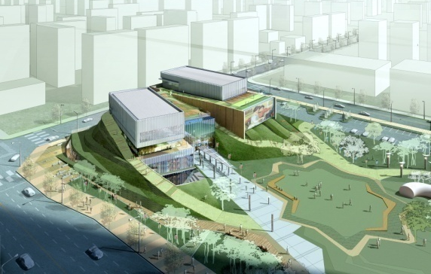
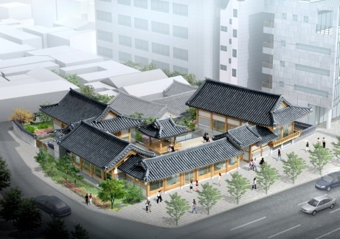
Establishing the circumstances for cultural creative activity in citizens’ communities
01. Establishing cultural facilities based on genre and region
Constructed Hannam-dong theaters for musicals and pop music: opened Nov. 2011.
- Pop music (1,268 seats), musicals (1,600 seats), and others (29,625㎡)
Constructed Northern City Art Museum: commenced in Mar. 2011 and will open in Apr. 2013 (56.7 billion won)
- Exhibition center, studio, gallery café, etc. (13,630㎡)
Constructed Chang-dong multiplex theater: commenced in Jul. 2011, and will open in Dec. 2013 (56.7 billion won) (private investment)
- Multi-purpose theater (1600 seats), musicals (800 seats), children’s theater (310 seats), Cinema (1250 seats), etc.
Donhwa-mun traditional, cultural facility: commenced in Aug. 2012, and will open in Oct. 2013 (41.6 billion won)
- Digital museum for palace life (1,700㎡), Donhwa-mun Traditional Music Hall (1,630㎡)

Slide 39
Task 2
Expanding the library and museum in every corner of town
Rather than large sized ones, constructing small libraries and museums
that are regionally specialized and supporting their active operation
Status
Easy to install a small library and museum, and necessary to develop a new model for steady operation.
Continuous needs for constructing a given size public library (8 base libraries)
2012
Plans
Seoul reading a book, expanding libraries and supporting its activation
- Constructing and operating a landmark library (Opens in Aug. 2012)
- Status of public library: 187 places (‘11) → 194 (‘12) / Geumcheon-gu, Dongjak-gu (7 places)
- Traveling libraries by celebrities’ recommendations and donations (200 places)
and support for public or private small libraries and museums (300 places)
Setting up and operating specialized libraries and museums
(3 pilot places, and through 2014, 30 places or more)
- Acquiring and operating the space for sharing celebrities’ valuable materials, local cultural assets, specialized goods(Modern great men in Suyoo-gol, Namsan Human Rights Park, bar members,
journalists, fashion and sewing museum, etc.)

Slide 40
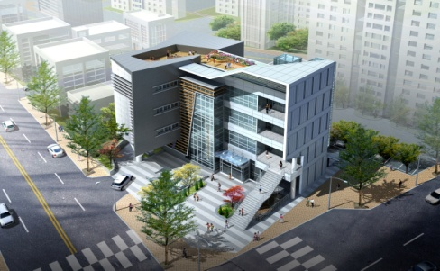
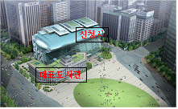
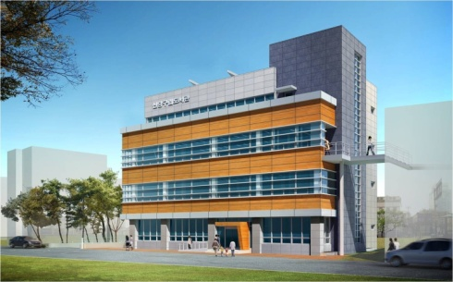
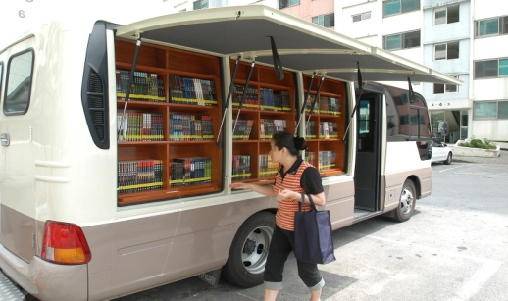
Opening the libraries and museums to breathe with the citizens
01. Public libraries
: Constructing a library network
Landmark library
(Opens in Sep. 2012)
Sphere (base) library
Local library
02. Visiting (mobile) library
Han River and parks as a resting and cultural reading space
_ Installing and operating a mobile container (small) library
_ Mobile library for areas isolated from libraries : establishing and using a traveling (mobile) library vehicle
40

Slide 41
Task 3
Increasing the cultural art programs created along with citizens
Through citizens’ voluntary participation, solving the divide in enjoying cultural art & contributing to the restoration of the local community
Status
Income disparity when considering cultural art enjoyment
Increased needs for citizens’ to voluntarily join cultural art activities
2012
Plans
Initiate sharing of citizen artists’ talents to extend chances to enjoy culture in daily life by:
- Culture sharing by visiting culturally-disadvantaged areas and facilities, culture delivery service (600 performances)
- Village’s free open art theater by talent sharing (50 places, 200 organizations, 1,000 times)
- Using the city art museum, the works in citizens’ possession to operate the art bank and visiting exhibitions (6 areas)
Expanding cultural art education by participation/experience type, based on community
- Town orchestra for child and youth: 90 person (2 areas) → 270 (6 areas)
- Dream harmony orchestra: 60 (including 10 persons under the control of the youth probation office)
- Education for children and youth (10,000) relating to the five-day work and the elderly (600)
Through talent sharing and personal cooperation, contributing to the cultural
enjoyment and creative sensitivity development of the cultural-disadvantaged class
41

Slide 42
Increasing the cultural art programs created with citizens
01. Open art theater
(50 places (’11) → 100 places (’14)
Introducing regular programs for cultural art appropriate for space size and features
Core space
Seoul’s representative cultural art attractions (5 places in 2011)
2,000 or more seats in a large space (Dream Forest Garden 5, Pyeonghwa Park, Neung-dong, Seoul Plaza, etc.)
Base
space
Local base of culture art where citizens and artists can enjoy together (25 places)
Middle-sized space receiving more than 700 per performance
Once or more monthly, complex for special artist and amateur
Life-attached
space
Village cultural shelter with fun and relaxation (river, streets, and forests, 35 places)
Small space receiving 700 or less per performance
Specialized as the weekend regular performance, amateur art space
Organization of system
Seoul City · District
Cultural happiness coordinating center
Company
Art group
Space – facility support
Space – activity resource matching
Supporting goods and equipment
Art volunteer service
42

Slide 43
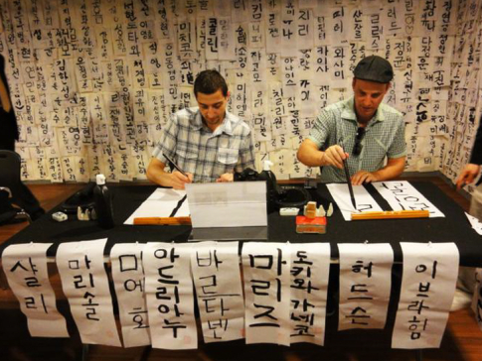
Increasing the cultural art programs created with citizens
02. Making Gwanghwamun Square into a landmark of cultural art
Memorial festival to be held at Gwanhwamun Plaza
_ The Story of Admiral Yisunshin(4.28~29)/Yisunshin’s Birthday, King Sejong Festival (10.. 9 / Hangeul Day)
_ Developing a storytelling type of history theme festival relating to King Sejong and Admiral Yisunshin stories
Establishing Sejong Cultural Art Belt
_ 27 cultural resources condensed with performance, museums, art museums, and others
_ Integrated information center for cultural tour at the basement of Haechi Madang (digital gallery, etc.)
_ Developing the tour packages and courses such as ‘10,000 won’s Dream’
“Gwanghwamun S-day”: Once a month _ Citizen-participating festival, monthly at Gwanghwamun

Slide 44
Increasing the cultural art programs created with citizens
03. Expanded facility beneficiaries by culture delivery and visiting service
Large welfare facilities
(30 persons or more)
Culture delivery service to ins and outs (once quarterly, 240 facilities)
Performance visiting the general welfare centers for the elderly and handicapped
Small welfare facilities
(30 or less)
Small facility without theater or with few users (once quarterly, 58 facilities)
Regional grouping (5~6) → invitation to a free performance by using local cultural art centers as a base facility.
Culture Atti
Cultural art volunteers to facilities (members of university art club) 1:1 sister affiliation
Cultural outing by sharing the performance and exhibition with the disadvantaged, recommendation of cultural information (Once a month)
Inviting university students for art volunteer service
Education
for
volunteer work
Sister relations
between the
facilities
Culture coordinator
Supporting cultural
excursion

Slide 45
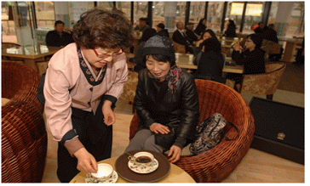
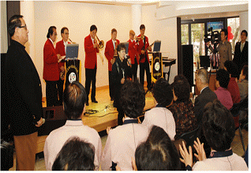
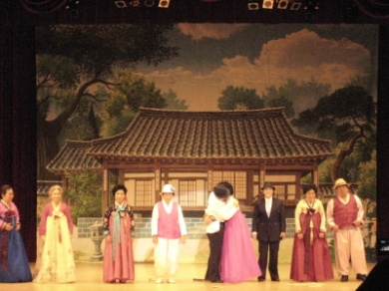
Increasing the cultural art programs created with citizens
04. Silver multi-culture spaces
_ Cultural welfare for energetic aging and the elderly
Constructing senior multi-culture centers by sphere (3 centers)
- One center was opened (Seodaemun Art Hall with 640 seats) on Oct. 2, 2010.
- 2 additional places to be constructed in the southeast and northeast areas
- Purchasing cinemas (over 300 seats), silver café, counseling center and other facilities
Expansion to elderly welfare complex
- Humanities lecture at theater, counseling center, and the employment office for elderly
Building up silver culture zones
- Elderly can use the neighboring restaurant, sports facilities, and cultural centers at a discounted price with a movie ticket.
05. Art college for dreaming youth
Using welfare facilities, culture arts center to operate an art college for each district (25 districts, 600 persons)
Opening regular courses for fine arts, performance, literature, and others, endowing a certificate, and encouraging citizens to make or join an art club.

Slide 46
Increasing the cultural art programs created with citizens
06. Seoul-type project for nurturing creative children
“Promoting future-oriented creative children with talents
by developing a private-public cooperative education model”
Developing a private-public cooperative model for rearing creative talents (MOU)
_ Seoul Metropolitan Government: cultivating culture art instructors, and supporting a tour for culture/sports facilities
_ Major company’s social contribution: financial support for operation
_ Social enterprise: operating an education program, and providing an instructor
_ College of fine arts: university student instructor (volunteer)
_ Education office: support with education space
Developing a customized education program with one specialty for each student
_ Field tours to cultural centers like Sejong Center for the
Performing Arts, landmark libraries, etc. with practical education programs
Art
Teach-er
Cul-ture
Program
support
Reading
Infra
His-tory
sport
Creative children’s meeting
Overseas training for creative children and teachers
Certification of creative school
46

Slide 47
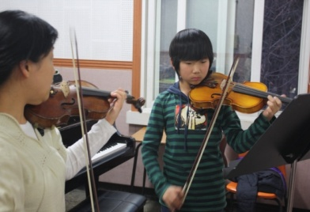
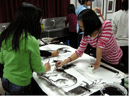
Increasing the cultural art programs created with citizens
07. “Offering Hope through Art” Program
With the effects of cultural art, encouraging
the low-income class to stand on their own feet
_ For the children of the head of household, opening Seoul ‘Hope Plus’ and ‘Dream’ accounts
_ Supporting the fee for practical courses for three pure art classes (music, fine arts, dance)
Staged support for discovering how to cultivate art-gifted children
Seed-sharing
Rearing young hopefuls
Cultivating human resources
Preschoolers ~ Elementary students
4th graders ~ High school students
Middle school students ~ University students
Support artistic (hobby) education
Support for discovering gifted children
Providing school fees for art
- Hope Sharing Camp: Participant’s chance to present the results and to make a social exchange
47

Slide 48
Policy Direction 2
Nurturing the Creative Industry,
a Blue Ocean for Creating Jobs
Establishing the foundation of the creative industry by supporting various creators and works.
Operating DDP, which is an advance base for the future creative industry .
Nurturing fashion, sewing, visual industry, and animation as the core industries of the future Seoul.
Using the historic and cultural resources in Seoul to seek smart tourism.

Slide 49
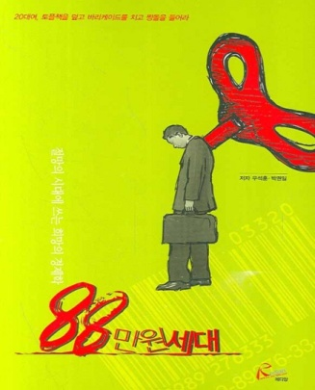
To need ideas for creating jobs and solving youth unemployment!
“10%” rate of youth unemployment
Not a recent problem, but a
chronic issue for 10 years
More serious…
Unsolvable problem, current growth without employment
Nation Land
Seoul
Source: National Statistical Office

Slide 50
Creative cultural industry has a big effect of creating jobs.
[$0.1Bil]
[%]
Global cultural market
Global rate of growth
Yearly 7% of growth
Size – $2.2 trillion”
Global market size
Source: Pricewater house Coopers, 2008
Inductive effect of cultural industry
Effect on production inducement
Cultural industry
2.11
Manufacturing
1.96
Service
1.68
Yearly 8% or more growth
Size – $500 Bill”
Employment inducement
(10 Bill investment)
Cultural industry
15.9 persons
Manufacturing
9.4 persons
Service
14.9 persons

Slide 51
“Creating jobs through Seoul-type creative cultural industry”
Projects
Setting up the creative industry district with concentrated areas of culture
Making a creation space as the cultural industry base
Cultivating a Seoul-type cultural enterprise
Establishing a self-supporting cultural market
Cultivating
creative
cultural
industry
Creating
cultural
jobs

Slide 52
Task 1
Support various creators/works to found the creative industry
With various supports for creators, constructing a virtuous circle of
Creation-Distribution-Appreciation-Investment to establish a
healthy cultural eco-system
In
Status
The existing support for creation is given by providing activity
cost and space, dependent on city budget.
Cultural management and artistic contribution mainly by major companies.
Ap
Culture
Com-munity
Cr
Di
2012
Plans
Supporting cultural art mecenat where companies and art groups co-exist
- Developing the differentiated operation model that Seoul City, companies, and art groups agree on
- Cooperating with the association of companies like Seoul Chamber of Commerce & Industry, Korea Federation of Small and Medium Business to attract companies’ participation.
「Master Plan for Creative Power Plant」leading the creativity to industry.
- Redesigning a creation space for social exchange between many creators
- Linking the creative activity of cultural art with social production activity
52

Slide 53
Supporting various creators and works to found creative industry
01
Dapsimni
‘Hub of Seoul antique fine arts network’
_ Establishing a cultural antique fine arts market, and the center of antique fine arts network (Sales-exhibition-education-auction)
_ Support for strengthening the specialized management skills of an antique arts shopkeeper’s cooperative
02
Seocho-dong
‘Classic music town district’
_ Connecting instrument shopkeepers with related businesses concentrated on the adjacent streets and constructing business processes
_ Strengthening amateurs’ capabilities and continuously inducing creative musicians
03
Namsan Yejang
‘Art tour district in nature’
_ Establishing a media-based performance art cluster, and giving a new cultural image to Namsan
_ High influx of Myeongdong population converted as a culture consumer
04
Mullae-dong
‘Cultural art town around factories’
_ Unique identity of a creation village in industrial areas due to a steady influx of a variety of experimental art genres
_ Activating communication with iron-industry community, leading to mutual community development

Slide 54
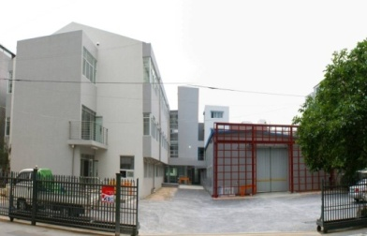
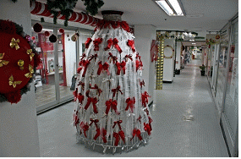
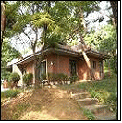
Supporting various creators and works to found creative industry
“ Intensively cultivating the production base of cultural industrial contents suitable for each creation space”
01
Gumcheon Art Factory
Discovery of creative ideas in technology art → development/production support
“ Digi-Cul”
(Digi-Cul)
_ Cooperative development by local industries and creators, and co-exhibition by Geumcheon artist and digital solution company
_ One of the works developed in 2010 is commercialized as a model case.
02
Sindan Creation Arcade
Sales support for new handicraft artist’s works and developing it as a tourist attraction
“ Creative handicraft”
_ Selling the creative artistic handicraft commercialized as a cultural commodity
Opening G Market and a permanent shop in Sindang Creative Arcade
_ Local resident’s tour(once a week), foreigner’s tour from Japan, China, and others
03
Yonhee Literature Creation Village
Cultivating the village as the consilience style of cradle of storytelling culture industry
“ Literature”
_ Providing novel and scenario writers with residence and creation support
_ Commercializing this village by connecting creation spaces, companies in other areas, supporting promotional marketing, and using musicals, movies, animation, cartoon characters, and others.

Slide 55
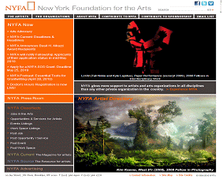
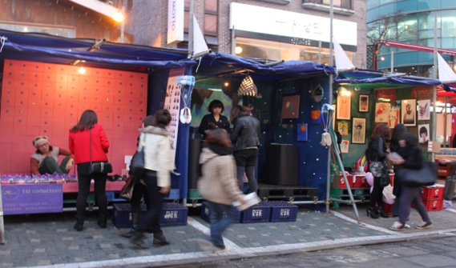
Supporting various creators and works to found creative industry
04. Developing online/offline art market
Constructing and enhancing online cultural art market (e-Culture agency)
_ Art volunteer (delivery) service, creative arts flea market, cultural jobs Running the cultural art portal providing cultural art program, support information, etc. (Opened in Nov. 2010) _ Enhancing the contents by providing web mobile service, etc. and improving the functions (2011)
Holding an offline art support expo
_ Introduction and application of cultural art support project, corporate support, investment mediation, employment consulting
05. Establishing and operating art markets by district
In affiliation with creation space, Hongdae flea market, etc., setting up small art
markets, such as the Han River, creation space, part, and others
06. Installing and operating Seoul Art Bank
Lending instruments, stage costumes, and stage equipment
and providing a practice space
Operating with an online/offline art education program

Slide 56
Task 2
Operating the DDP, an industry base of future creative jobs
Establishing multiplex base of culture, tours, and design
Creative cultural space with participation, considering field arts by local artists
and developing DDP’s unique contents like the Korean Wave
Status
Undecided contents, operation method, opening date, fee, and other matters.
Needs the general development plan for leading the northeastern area of industry.
2012
Plans
Making grassroots artists’ creative spaces for developing contents
- Citizen-participating activity space and development of DDP’s unique contents like the Korean Wave
Determining the operation entity of DDP and its plan
- Operation of design foundation vs. appointment of specialist, and deciding DDP opening date, fee policy, etc.
Establishing development plan for neighborhood of DDP
- Development plan for neighborhood industry , district unit planning , maintenance of street and night views
56

Slide 57
Nurturing fashion, image, contents and animation
as the representative creative industries of Seoul
Task 3
By vitalizing the local fashion and sewing industry
& by supporting the production of images and animations
Status
Poor working condition of the fashion and sewing industry lowers workers’ performance
High risk in producing films and animations and difficulty in investment and distribution
2012
Plans
Establishing the「Good sewing workplace」
where workers can make the clothes happily
- Improving the sewing workplace, making the workplace safe and healthy, a design reform
Newly setting up the「Scenario writer’s zone」
to support the creators in poor condition
- Linking with the existing workrooms of the film director, PD, and producer
- Strengthening the communication among creators through lectures, mentoring, etc.
Constructing a private-public cooperative system
for reviving domestic animation
57

Slide 58
Nurturing fashion, sewing and animation as the representative creative industries of the future Seoul
01 Establishing “Scenario Writer’s Zone”
Joint work-room
Information
lounge
Organized support for the participants of movie creation (Director, PD, writer)
Constructing the mecca of movie creation in connection
with the existing facilities
- Operating a variety of workrooms and an information lounge
Group work-room
Individual
work-room
02 Activation of animation by private-public cooperation
Cooperative work between animation and broadcasting companies
Support for producing digital contents under excellent planning, such as games, animation, etc.
Holding SPP (Seoul animation market) and an export consultation session
for east Asia, Europe, and other overseas markets

Slide 59
2,000 Years Old,
Historic Capital, Seoul
We’ll discover its cultural value.

Slide 60
We will discover the cultural value of 2,000 years of the historic capital, Seoul
Registering the longest and largest ‘Hanyang Castle’
as the world cultural heritage
Status
Gyeonggi-do will register Namhansanseong as the UNESCO world heritage .
Necessary to systematically investigate, research, and prove the value of world heritage
2012
Plans
Spontaneous application for registration of Namhansanseong,
Bukhansan-seong and Tangchundae-seong, centered on「Hanyang Castle」
- Forming a national consensus that such access shall be made in terms of national interest
- Intensive focusing on the value of world heritage
- Strong appeal by early organization of task force and transfer of mayor’s residence.
Arranging the plan for sustainable preservation, management,
and use of castles meeting the world standards
- Basically improving the noxious environment relating to castle preservation
- Systematically preserving and managing by raising the authenticity of the existing restoration courses, etc.
- Arranging the program connected with the neighboring attractions and enhancing accessibility, etc.

Slide 61
We will discover the cultural value of 2,000 years of the historic capital, Seoul
2,000 years of historic city, Seoul,
with great views, history, and culture
Seoul has compressively developed from the city of kingdom to a global city
Nature
Naesasan (Mt.)-Waesasan (Mt.)
Han River - streams
History
Diversity
People
Dynamism
Culture
Compressive urban growth
Megacity of 10 million
근대의 압축적 발전

Slide 62
We will discover the cultural value of 2,000 years of the historic capital, Seoul.
But, Seoul
lost and impaired lots of its cultural assets over the eras of Japanese occupation and compressive growth.
The crisis that the daily life history and uniqueness of Seoul may disappear due to New Town and reconstruction.
“ More efforts to shed new light on the value of the unprecedented historic cultural city in the world

Slide 63
We will discover the cultural value of 2,000 years of the historic capital, Seoul.
5th City government is focusing on discovering & using
the value of creative cultural heritage
4th government
5th government
Public preservation by gov.
Privately-led use and preservation
History of Chosun Dynasty
_ Downtown preservation area of historic culture
2,000 years of urban growth history
of Hanseong Baekje
_ Expansion and use of cultural
preservation areas
Point preservation
_ Downscaled cultural assets
Regional and scenic preservation
_ Preservation by creating cultural aura
Restoration and maintenance of original state
_ Centered on cultural assets and historic cultural heritage
Value-finding by using cultural assets
_ Including the life history of ancient
and modern times

Slide 64
Task 1
Retracing 2,000 years of Seoul history
01 Pushing forward the research project for Seoul 2000
Installing a research team for reviving 2,000 years of history in City Cultural Information Service
Discovering the records on prehistoric and ancient Seoul to arrange them systematically
Operating the ‘Seoul History Culture Forum’ where academic circles, media, and citizens join (Holding a domestic or foreign symposium, etc.)
02 Constructing and operating Hanseong Baekje Museum (Open in Apr. 2012)
Museum that specializes in prehistoric and ancient history
Exhibition on future-oriented experience through 4D IT & a panorama display

Slide 65
Task 2
Preservation of Seoul castles and the historic culture inside the four castle gates
01 Restoring Seoul castle and Donuimun
Completing the restoration of the 13.5km section of Donuimun and 72% of Seoul castles by 2013
Starting the restoration after a feasibility investigation and master planning
02 Arranging the general measures for the preservation of the
insides of the four castle gates
Introducing the public analysis of the culture asset index,
and constructing an integrated DB system
Suggesting the guideline for a cultural asset index investigation,
regional development and preservation

Slide 66
Task 3
Finding and preserving historic cultural assets
01. Finding and preserving the assets that are in the possession of citizens
Increasing the risk of impairing and smuggling the assets in the
possession of individual and private museums
Systematic preservation and management with the finding of
cultural assets through voluntary gifts and the invitation of them
02. Village history exhibition center
_ Preserving the historic assets of the future
Making a digital archive of the materials showing the people’s
life history and spaces in Seoul disappearing due to the new
town and downtown reconstruction.
Encouraging the streets and buildings preserved and the regional life history museum built upon the development of an area

Slide 67
Task 4
Project for using the value of historic cultural resources
01 Meeting Seoul history and scenery again
_ Discovering Seoul’s historic and cultural tourist attractions
241 works, including landscape paintings, poets, traditional poems, etc.
_ This selection of reproducible works was created through a field survey in 2011
_ Installing in 50 places till 2014 (10 demonstrations done in 2011)
Putting an art board at the view point of the work (picture, comment on the work, etc.)
Executing the lay of the land in the scenery and running
a program for exploring cultural remains with a cultural remains
commentator

Slide 68
We will find out the cultural value of 2,000 years of the historic capital of Seoul.
02 Project for finding the value of Seoul castles
4 Main Gates
Heunginjimun
Historic culture/fashion zones (Dongdaemun History & Culture Park, castle fashion show)
Sungnyemun
Festival culture zone (Sungnyemun Plaza, reproduced market from the Joseon Dynasty)
Donuimun
Performance art zone (Woram Park, outdoor performance)
Sukjeongmun
Observation zone (castles from Baegaksan (Mt.) to Inwangsan (Mt.), observation deck)
Participation by Citizens
Keeping-all-together
Castle custodian family of the four gates, castle commentator
Restoring-all-together
Writing a wish on a roof tile or castle stone and donating towards restoration expenses
Enjoying-all-together
Castle concerts (8 places), Seoul’s 8 great fortress wall views

Slide 69
69

Slide 70
Thank you

